Slide 1

PIXEL PLATFORMER
066-Sudesh Rajbhar

Slide 2
INTRODUCTION:-
Platform games (often simplified as platformer or jump 'n' run) is a video game genre and subgenre of action games in which the core objective is to move the player character between points in a rendered environment.
The most common unifying element of games of this genre is the ability to jump.
LANGUAGE :-
This game is developed using python.
There are various frameworks which help in developing games like Pygame.
In this game, we have used Pygame framework. We have a character/pixel in the game, and he must cross all the obstacles in the way using the arrow keys.
The player has the control of the character, but the obstacles cannot be controlled by the player. We have used arrow keys to move the character back and forth and jump when necessary

Slide 3
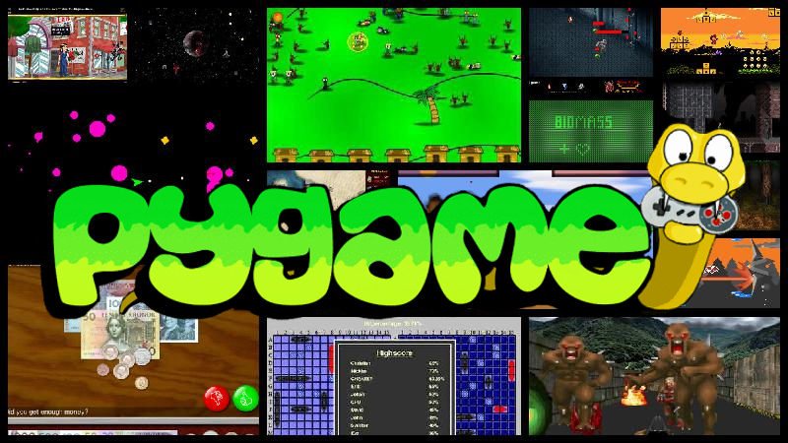
PYGAME MODULE:-
Pygame is a cross-platform set of Python modules designed for writing video games. It includes computer graphics and sound libraries designed to be used with the Python programming language.
There is basic formula from classical mechanics to make an object jump.
F = 1/2 * m * v^2
Where F is the force up/down, m is the mass of the object and v is the velocity. The velocity goes down over time because when the object jumps the velocity will not increase more in this simulation.
When object reaches the ground, the jump ends. If is jump variable is True or False it indicates object is jumping or not. If is jump is True, object position will be updated according to the above formula.

Slide 4

THE GAME:-
The “Pixel Platformer “game is an entry level game directed towards the kids.
The main objective of this game is to surpass all the obstacles coming in the way and reach to the top. If the player misses with any platform, the game gets over and player must start again.
The player can surpass the obstacles by jumping over it with the arrow key controls.
We have made this game very fun to play. This is a very easy game , and people of any age group can play this game, but more emphasized towards the age group of 5-13.
MAIN ASPECTS OF THE GAME:-
1.Game Environment.
2.Collision Detection.
3.Player movement.
4.Jump mechanics
5.Gravity mechanics
6.Scrolling of screen
7.score counter
8.Game over
9.Random platform movement

Slide 5
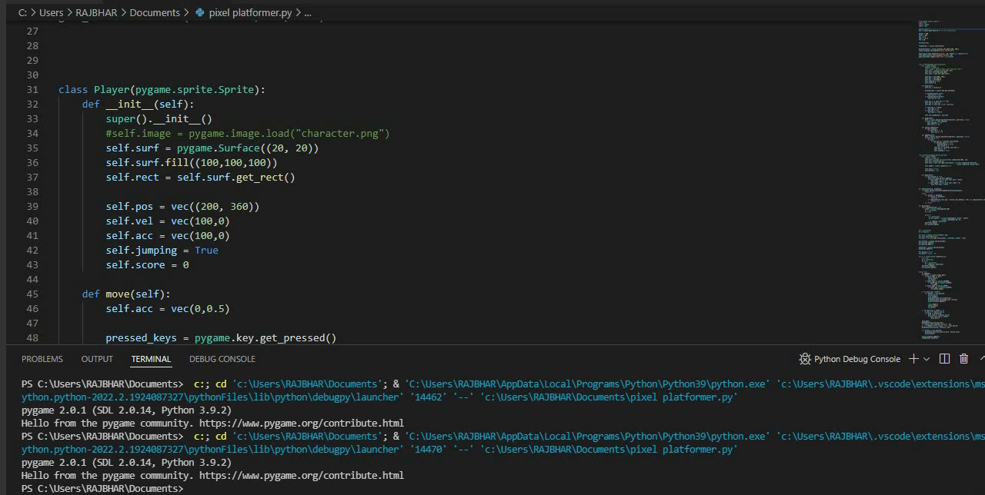

Slide 6

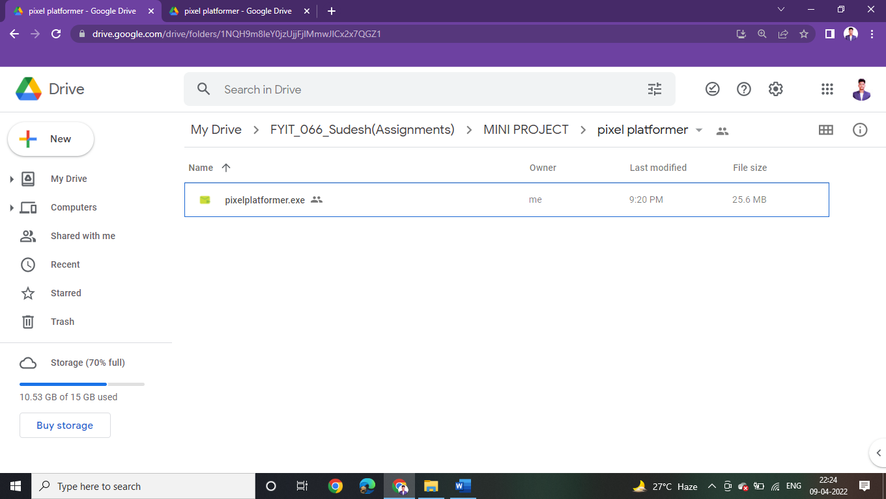
THE WEBSITE:-
indextest.html
GAME DOWNLOAD LINK:-

Slide 7
CONCLUSION:-
In conclusion, we have created “Pixel platformer” a platformer game using python. This is built using Pygame modules in python. This is a very basic level game which is primarily for kids but can be played by anyone for that matter.
Even though this game is an entry level game, platformer games like these are never out of the league in competition with other games, because of its simplicity and easy to play features.
REFERENCES:-
https://coderslegacy.com/python/python-pygame-tutorial/
https://youtu.be/Ongc4EVqRjo
https://youtu.be/oYRda7UtuhA

Slide 8
THANK YOU

